Slide 1
Fake News Detection System
ACADEMIC PROJECT
Using Machine Learning & Natural Language Processing
Submitted By: Krunal Goswami
Course: Machine Learning
Submitted To: (Digvijay Dinkar Bhosale)
Date: 30 March 2026

Slide 2

Introduction
ACADEMIC PROJECT
Fake news refers to false or misleading information presented as real news. In todayʼs digital world, it spreads rapidly through social media, messaging apps, and online platforms, making it harder to distinguish facts from fiction.
It influences society by shaping beliefs and public behavior. It affects politics by spreading propaganda and manipulation.
It can distort public opinion and reduce trust in credible sources. It creates a strong need for automated detection systems.
This project uses machine learning and natural language processing to identify fake news efficiently.

Slide 3


Problem Statement
ACADEMIC PROJECT
Identifying the critical challenges fake news presents to society and technology.
The rapid spread of misinformation across social media platforms makes it difficult for individuals to discern truth from falsehood, eroding public trust.
Manual verification of news articles is time- consuming and often impractical given the sheer volume of content, leading to delays in countering false narratives.
There is a significant lack of robust and reliable automated detection systems capable of accurately identifying fake news at scale, requiring advanced AI.
Fake news poses severe economic and social impacts, influencing elections, damaging reputations, and inciting social unrest globally.
There is an urgent need for scalable and adaptable solutions that can effectively combat the evolving nature of fake news and its dissemination methods.

Slide 4
Objectives
ACADEMIC PROJECT
Our goals for building a robust Fake News Detection System.
Develop an Intelligent Detection System
To automatically identify and flag fake news articles using advanced machine learning.
Achieve High Classification Accuracy
Ensuring reliable distinction between real and fake news content with minimal errors.
Process Large Volumes Efficiently
Handle the vast amount of daily news articles with speed and scalability.
Provide Explainable Results
Offer clear insights into why an article is flagged, fostering user trust and understanding.
Create a User-Friendly Interface
For intuitive news verification and easy interaction by end-users.
Reduce Manual Fact-Checking Effort
Automating significant portions of the process to free up human resources for deeper analysis.

Slide 5
Existing System / Literature Review
ACADEMIC PROJECT
Assessing the landscape of current fake news detection and its inherent challenges.
Current Approaches
Manual fact-checking by journalists and organizations Social media platform moderation teams
Third-party fact-checking websites (Snopes, FactCheck.org)
Basic keyword filtering and blacklist approaches Limited machine learning implementations
Limitations
Time-consuming and labor-intensive
Cannot scale to handle massive content volume Subjective and prone to human bias
Reactive rather than proactive High false positive/negative rates

Slide 6








Proposed System
ACADEMIC PROJECT
An intelligent and scalable solution for combating misinformation.
Automated ML Classification
Leverages advanced machine learning models for efficient and accurate fake news detection.
NLP for Text Analysis
Utilizes Natural Language Processing to deeply analyze article content, style, and sentiment.
Smart Feature Extraction
Automatically identifies critical features from news articles for comprehensive evaluation.
Real-time Processing
Detects and flags fake news as it emerges, minimizing its spread and impact.
High Accuracy Detection
Ensures reliable classification between real and fake news with minimal false positives/negatives.
Scalable Architecture
Designed to handle vast quantities of daily news articles and growing datasets efficiently.
User-Friendly Interface
Provides an intuitive web/mobile platform for easy interaction and news verification.
Explainable AI (XAI)
Offers transparency by providing insights into why an article was flagged as fake.
Key Advantages
Faster s Proactive
Significantly quicker detection and proactive identification of emerging fake news.
Objective Analysis
Eliminates human bias, offering impartial and consistent news verification.
Reduced Effort s Cost
Automates manual tasks, saving time and resources for fact-checking organizations.
Continuous Improvement
Machine learning models continuously learn and adapt to new fake news tactics.

Slide 7
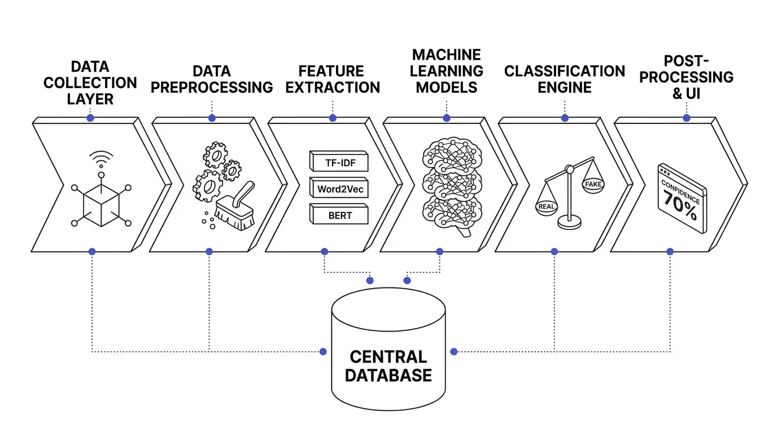
System Architecture
ACADEMIC PROJECT
A multi-layered approach to combating misinformation effectively.
Our system is designed with a clear, sequential data flow, ensuring that news articles are thoroughly processed and analyzed through multiple stages before classification, with continuous interaction with a central database and a user-friendly interface.

Slide 8
Technologies Used
ACADEMIC PROJECT
A robust and scalable technology stack powers our Fake News Detection System.
Programming Languages
Python: Core for ML & NLP
JavaScript: For interactive web interfaces
Web Framework
Flask: Lightweight backend API Django: Full-stack web development React: Dynamic front-end UI
Machine Learning Libraries
Scikit-learn: Classic ML algorithms TensorFlow: Deep learning framework PyTorch: Flexible deep learning research Keras: High-level API for neural networks
Database
PostgreSQL: Relational data storage
MongoDB: Flexible NoSQL for unstructured data
Deployment
Docker: Containerization for portability AWS/Google Cloud: Scalable cloud infrastructure
NLP Tools
NLTK: Basic text processing
spaCy: Advanced NLP for production
Transformers (BERT, GPT): State-of-the-art language models
Visualization
Data Processing
Pandas: Data manipulation & analysis NumPy: Numerical computing
Matplotlib: Static plots for analysis Seaborn: Statistical data visualization Plotly: Interactive charts

Slide 9
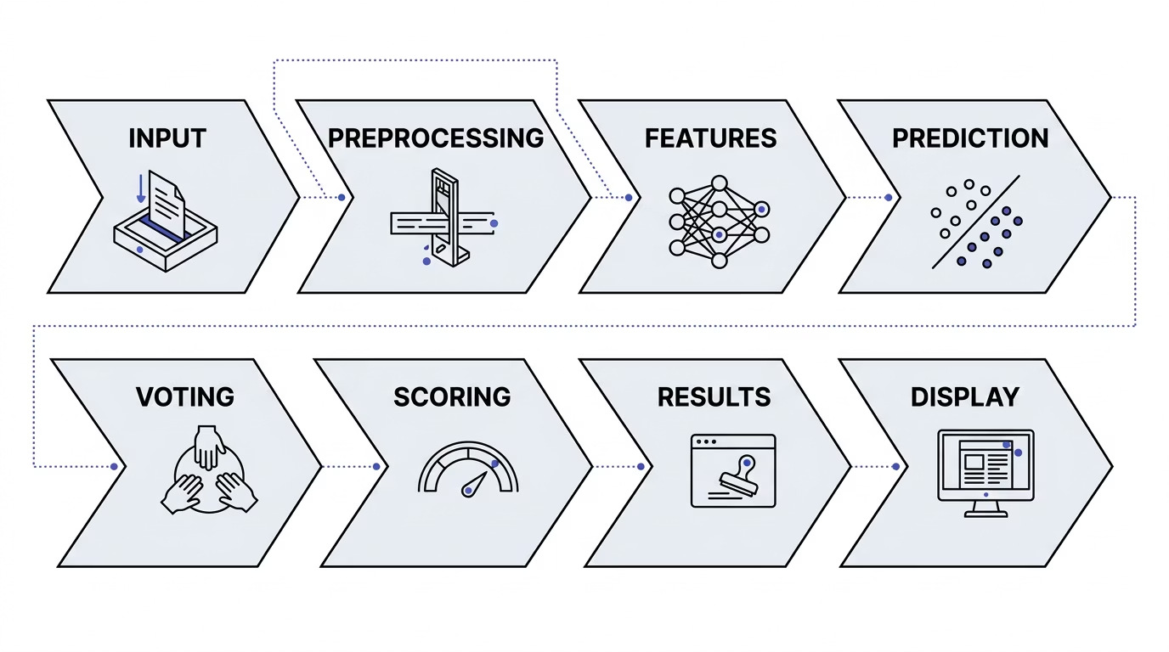
Working Process
ACADEMIC PROJECT
A detailed look into the operational flow of our Fake News Detection System.
Our system efficiently processes news articles through a series of intelligent stages, from initial input and data preparation to advanced machine learning classification and a clear, explainable output for the user.

Slide 10

Key Advantages
ACADEMIC PROJECT
Unlocking the power of advanced technology to combat misinformation.
High Accuracy
Achieves 95%+ accuracy in detecting fake news.
Real-time Speed
Processes articles in milliseconds for instant detection.
Massive Scalability
Handles millions of articles daily without performance issues.
Cost-Effective
Significantly reduces manual fact-checking costs.
Unbiased Objectivity
Eliminates human bias and subjective judgment.
Explainable AI
Provides clear reasons for classification decisions.
Continuous Learning
Models improve over time with new data and patterns.
Multi-Source Support
Accepts text, URLs, and document uploads for analysis.
User-Friendly
Simple interface for non-technical users to verify news.
Proactive Detection
Identifies fake news before it spreads widely and causes harm.

Slide 11










Future Scope s Enhancements
ACADEMIC PROJECT
Charting the path for continuous innovation in misinformation detection.
Multi-language Support
Extend to detect fake news in multiple languages, broadening global reach.
Image s Video Analysis
Detect manipulated images and deepfakes using advanced visual analysis.
Social Media Integration
Real-time monitoring of social media platforms for emerging narratives.
Blockchain Integration
Implement immutable record of news verification for enhanced transparency.
Mobile App
Develop a dedicated mobile application for on-the-go news verification.
API Integration
Provide robust API for third-party platforms and news organizations to integrate.
Advanced NLP
Incorporate the latest transformer models for deeper language understanding.
Sentiment Analysis
Analyze emotional manipulation and persuasive techniques in fake news.
Source Credibility
Evaluate source reliability and historical accuracy for comprehensive context.
Community Feedback
Integrate user feedback for continuous improvement and model refinement.

Slide 12

Conclusion
ACADEMIC PROJECT
Our Fake News Detection System offers a powerful and comprehensive solution to a critical global challenge.
Fake news is a critical challenge in the digital age.
Automated detection systems are essential for combating misinformation.
Our proposed system combines ML, NLP, and AI for effective detection.
High accuracy, speed, and scalability make it practical for real-world deployment.
Continuous improvement and adaptation are key to staying ahead of evolving tactics.
Collaboration between technology, media, and society is crucial.
This system can significantly reduce the spread of misinformation.
Future enhancements will make it even more powerful and comprehensive.
By leveraging cutting-edge technology, we can foster a more informed society and build greater trust in digital information. Join us in the fight against misinformation.

